Slide 1
Early warning system for risk mitigation
Ivan Cipriani

Slide 2
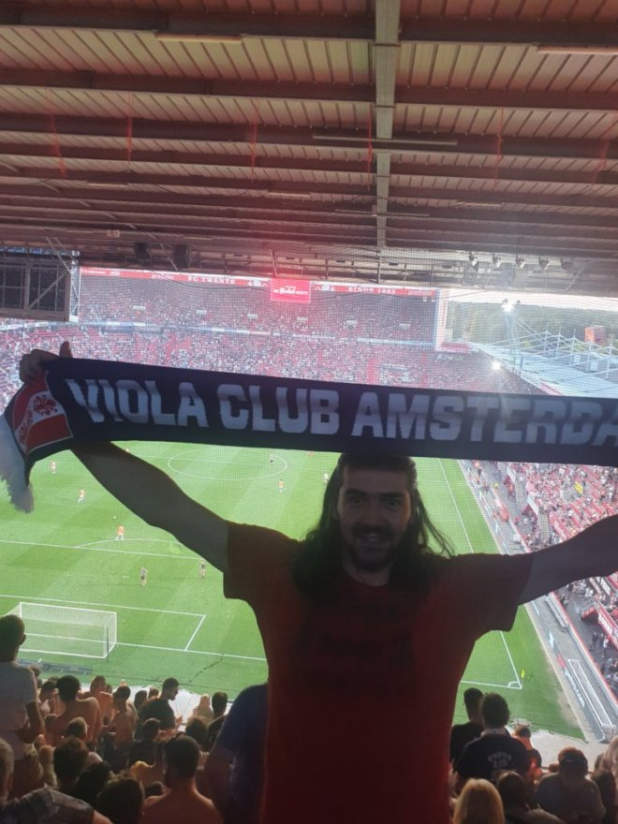
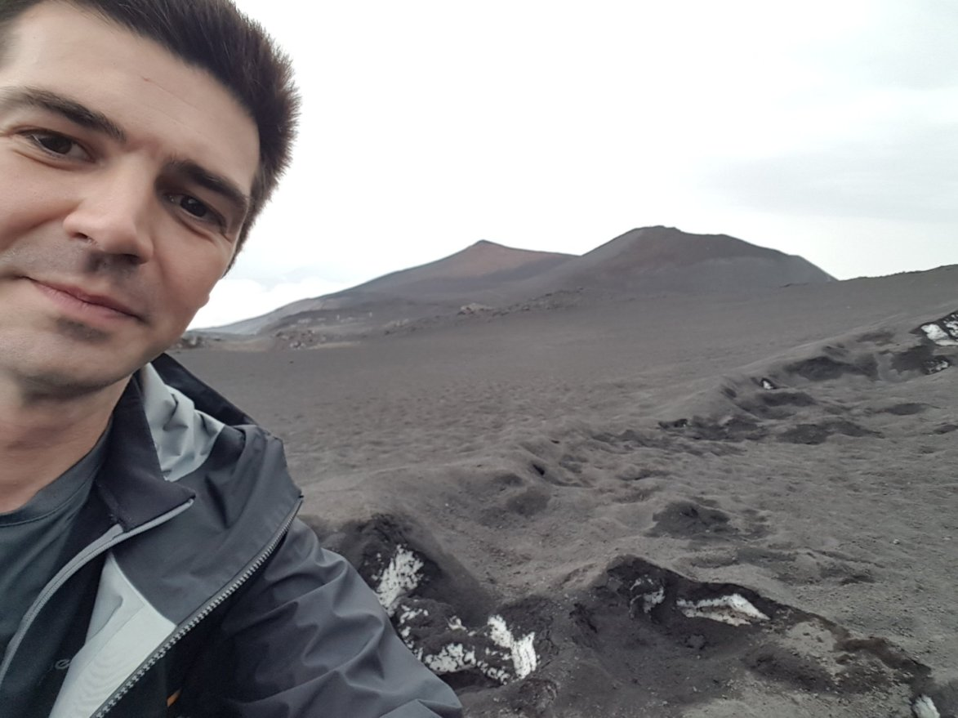
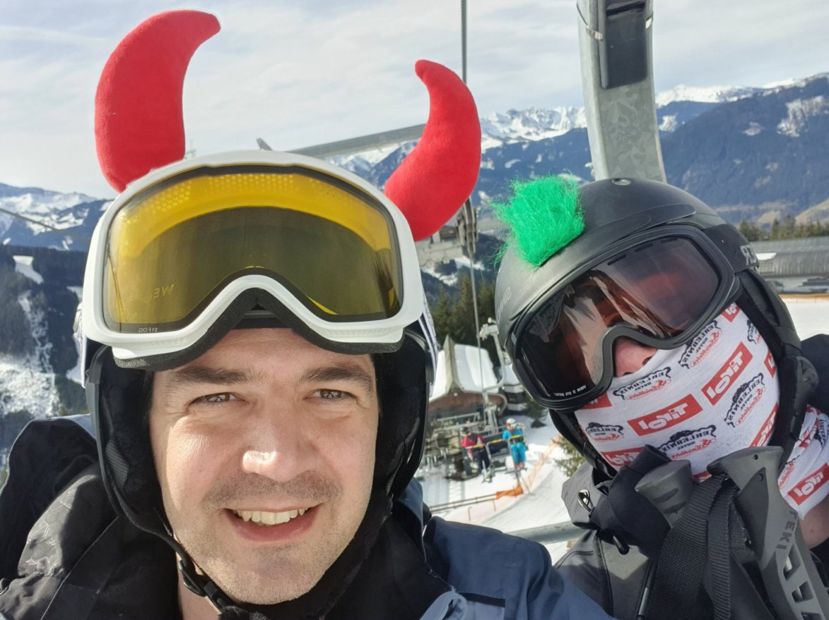
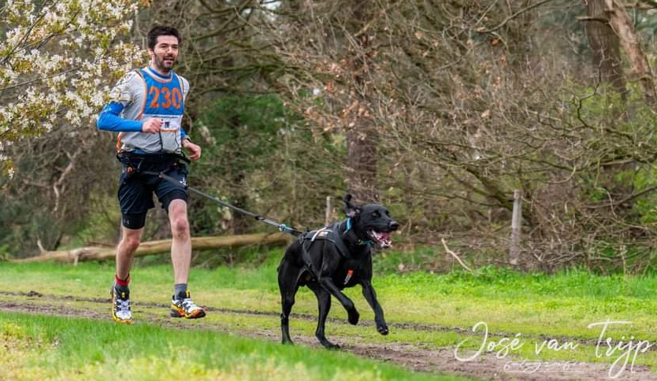
Personal introduction
About me
I am a software developer with certification on Microsoft technologies, scrum, tests and dev-ops with a university background in geology with some papers still mentions after 10 years.
In my spare time, I like to run with my dog, hiking in the mountains, ski and support Fiorentina.
Notes:
We can later in details about this papers
Canicros I can talk for al leats 20 minutes but show must go on

Slide 3
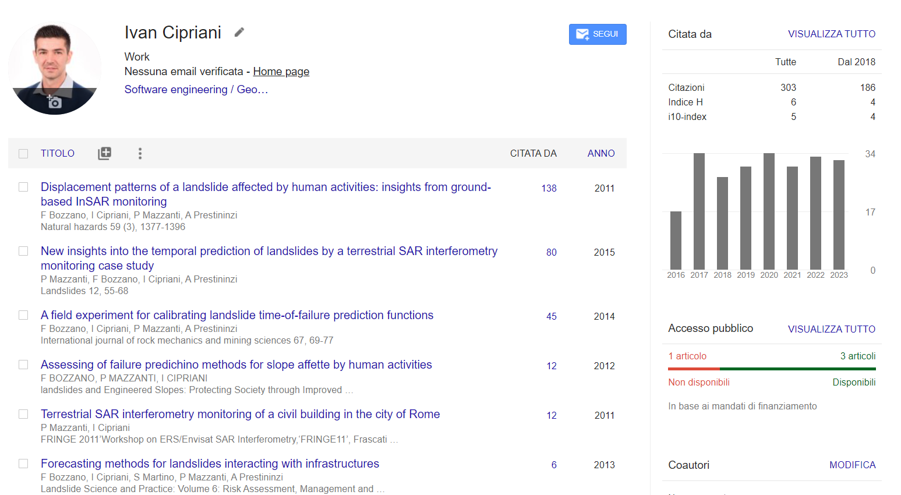
My technical profile
Notes:
We can see that still on the 2023 is quiate mentions... I hope like something good (but better not ot check). Reference
We win also a price in aconference in germany where manily enginerring and a conference mainly fro them where there so for us all geology was a win that the value was double.

Slide 4

Agenda
Nuggets of wisdom (fun facts)
Introduction of the case study
Description of the monitoring system
Semi empirical models applied
Final result
Discussion about Risk mitigation
Time: 45 minutes not more
Notes:
Do not expect to much on the physic behind the radar at then end I am a geologist adapt to computer science and probably people working for asml can give a very bettr explaination easy to understand also for me ☺
So for the eroic guy that will be also a the one on git don't worry there will be only one emulate uncle bob (see to visit uncle bob)
So a the end there will be a discussion of how risk mitagatin methodologie or techinche use in geology are also possile to use in it sector

Slide 5
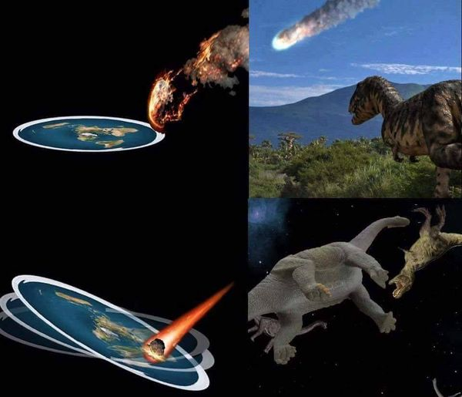
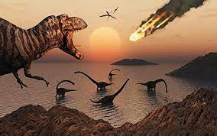
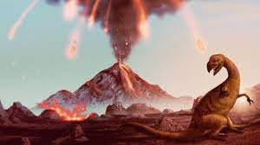
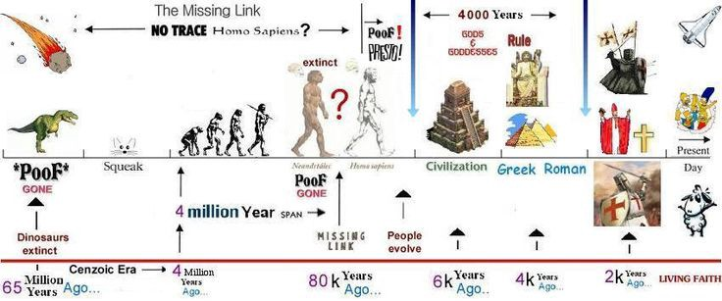


Nuggets of wisdom
Decrease temperature
When? 65 million years ago
Why?
5
Notes:
This is the most if you think that the earth is flat this is another option and the probabilty tha flat earth is between us in this room is not so small
Instead if you think about the whole time of the earth like 24 hours we lived only one second.
The age of the earth is around 4,5 miliard of years un third of the univers

Slide 6
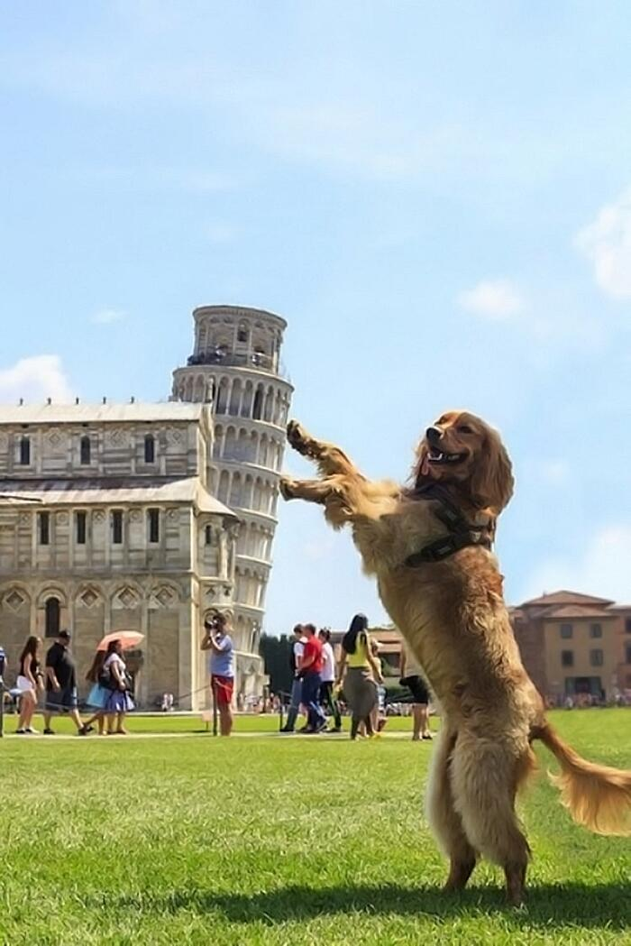
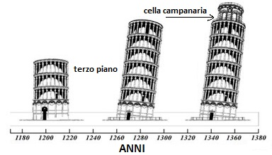
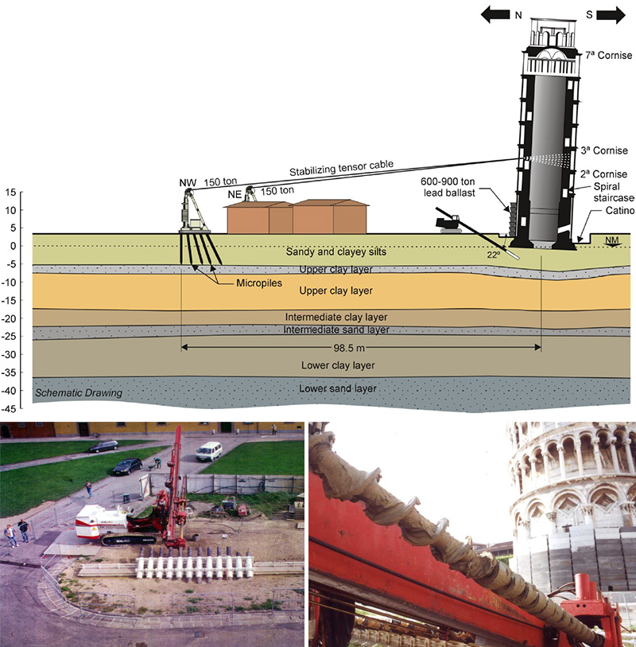
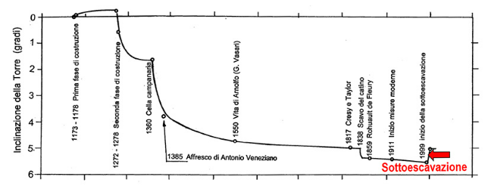
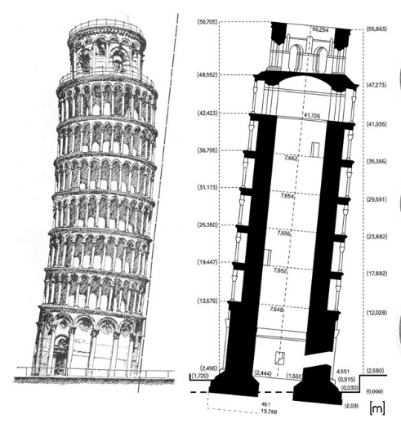
Nuggets of wisdom
New works
Stable
Open to visit
Marble basement
Not good
1835
1987
2001
With Piazza dei Miracoli
UNESCO World Heritage Site.
Notes:
Looking on the graph on the top we can see that the tower was build in three phases, this because money where finished that was the reason that save the tower to collapse and so make thsi on of the most famose tour in teh wworld an Unseco word heritage.
So why the stop of the work safe the tower to collapse because the tilt of teh tower was cause by a small difference of thickness in on of the layer of clay undr the tpwer, this layer normally compress so reduce the tichness under weight so teh stop of teh work allowed the terrain to consolidate more gradually and allowed the architedt to build the tower with this banana effect Banana effect to return to verticality During the consolidation works, which began in 1990 and ended at the end of 2001, the slope of the bell tower was reduced by encircling some floors, temporary application of steel tie rods and lead counterweights (up to 900 tons) and under-excavation, bringing it back to the one that, presumably, must have been 200 years old. Furthermore, the foundation has been consolidated to allow the tower to be safely maintained for at least another three centuries, thus allowing access to visitors. Starting in 2004, the restoration of all the external stone surfaces and the restoration and layout of the internal rooms began. Some of these interventions were carried out thanks to funds from the Lotto game, in accordance with the provisions of law no. 662/1996[12].

Slide 7
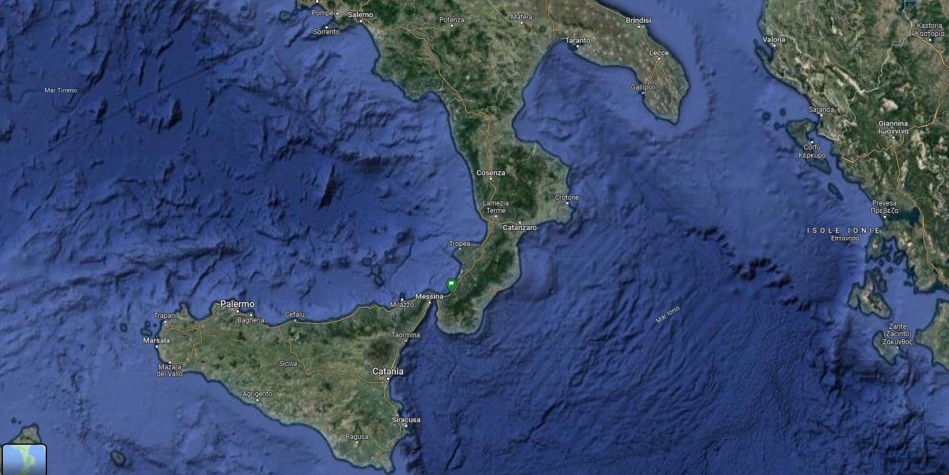
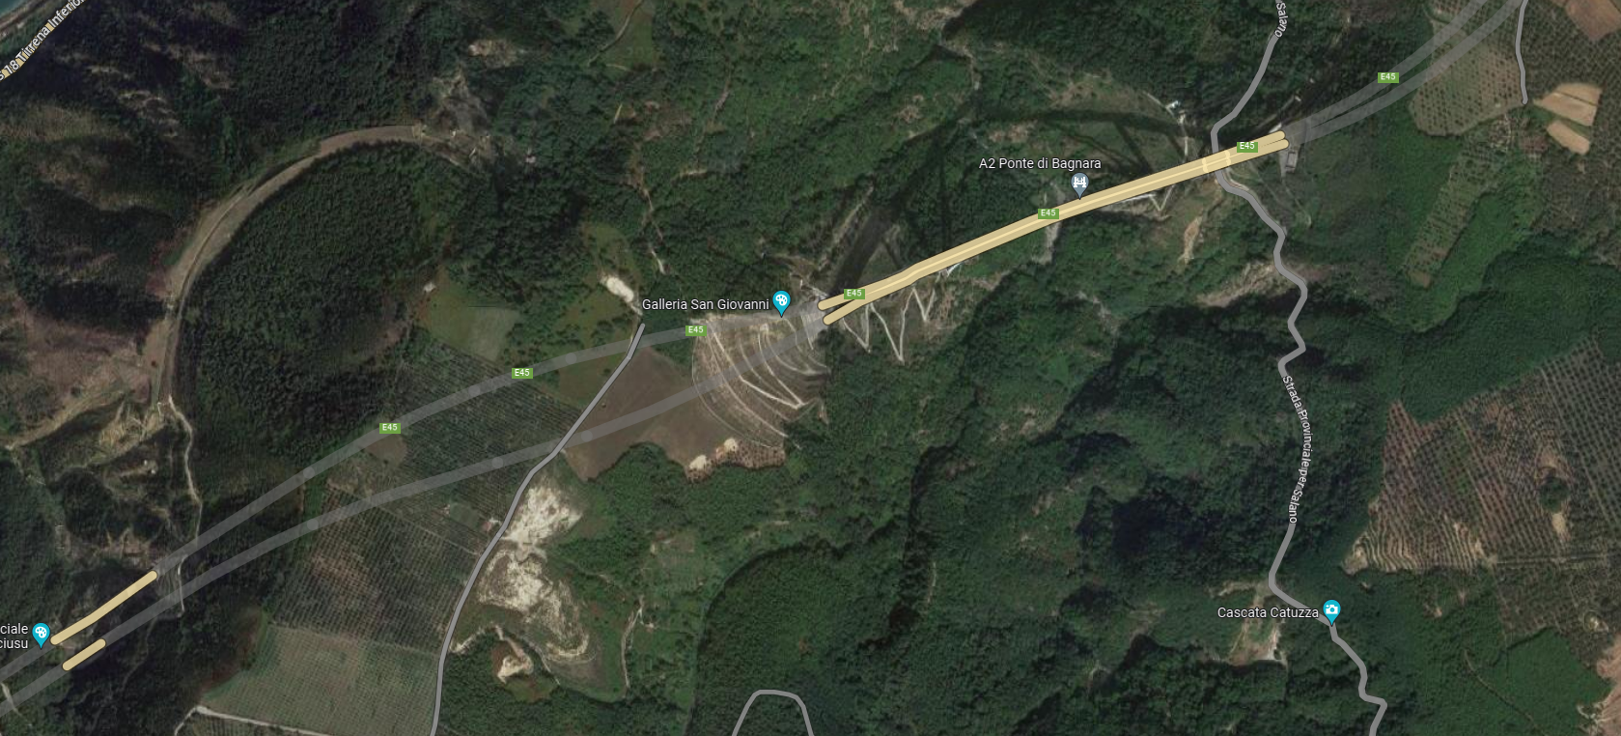
Introduction of the case study
Notes:
We can start to localize the infrastructure where the monitoring investigation was carry, this wa sin the salerno reggio calabra started to build in 1960 and enedned in 2017 because only after 10 year from the started of the work they realize that the car in country was increase exponential and that . Second longest high way in italy
Please try to remember this pictur ei detail because it will be imprtant to undestand how in Italia public money are "invested"
In the previous image you can see strange turn.. Maily do to orographic issue but osme of that for personl interest of political ma. Famoue for italian people is the one on the A1the autostda del sole milano napoli

Slide 8
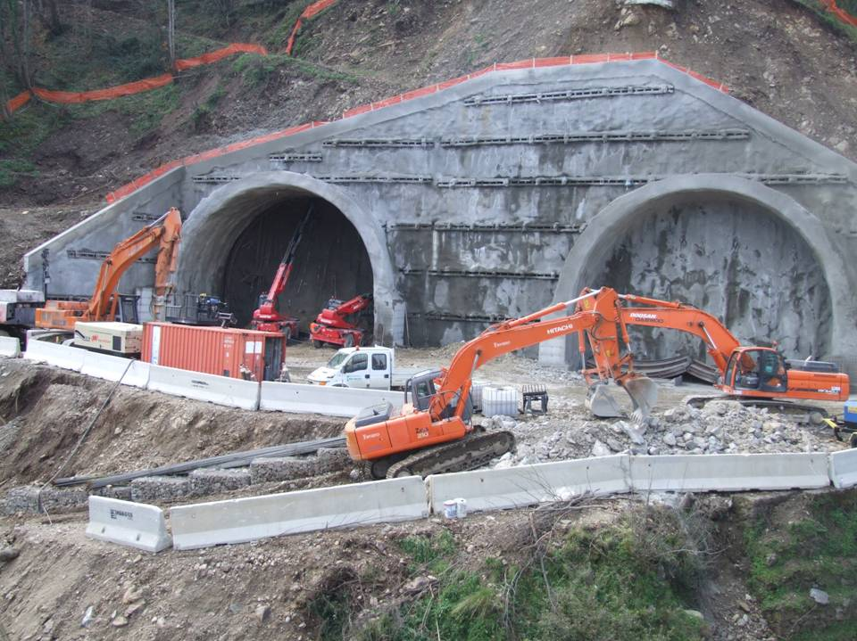
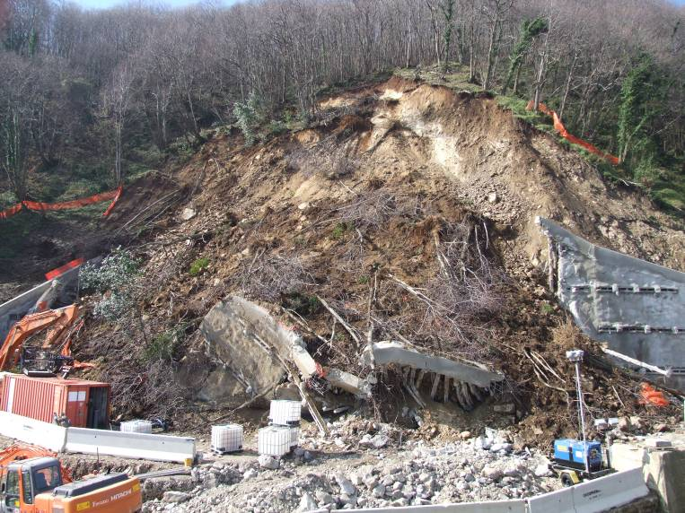
Introduction of the case study
2 Marzo 2007
Febbraio 2007
Notes:
There was not victim because the repsonsible of the work hear the roads broke
So after this event a solutio to monitoring the slope during the rebuild of the enter of the tunnel had beb thinked
But before that have a loo at the geology and geomorphology of the area

Slide 9
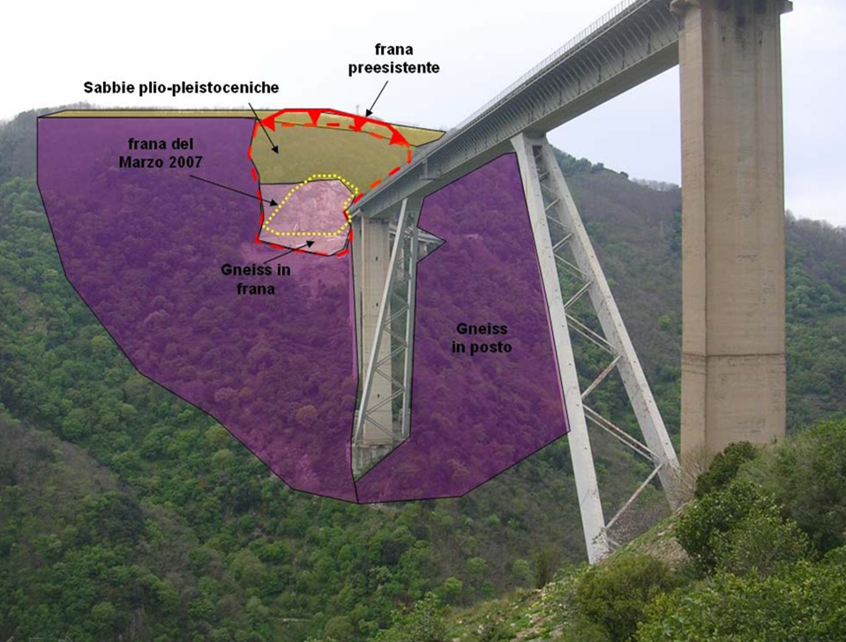
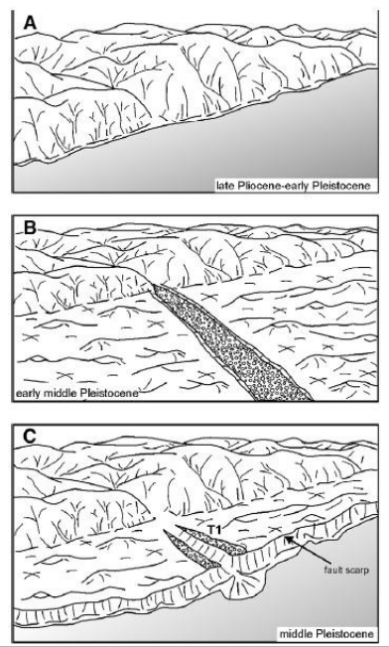
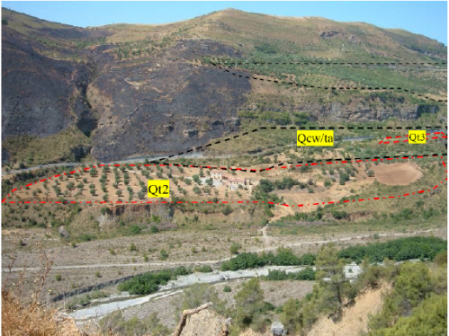
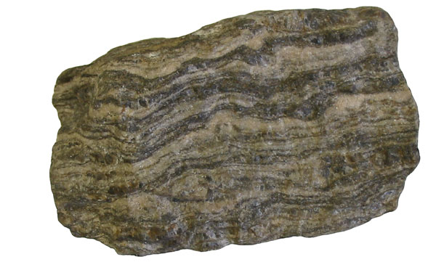
Introduction of the case study
Historical landslide
Landislide of 2007
Notes:
Old and new landslide
from German Gneis (German pronunciation [ɡnaɪs]) is one of the most common metamorphic rocks constituting the continental crust
It is the result of regional dynamothermic metamorphism of original rocks (protoliths) of sialic composition, i.e. rich in quartz and feldspars and poor in ferro-magnesian silicates. It forms at great depths, as a result of the changed conditions of pressure and temperature, in the convergence zones of two plates, during the subduction phase and the subsequent continental collision phase, which give rise to mountain chains.
Paleozoic Extends from approximately 542 to 251 million years ago.
The Plio-Pleistocene is an informally described geological pseudo-period, which begins about 5 million years ago (Mya) and, drawing forward, combines the time ranges of the formally defined Pliocene and Pleistocene epochs—marking from about 5 Mya to about 12 kya
chematic representation of filling events of the basins in Calabria. Tectonic activity leads to the
submergence of a basin (A). Marine regression results in the extension of a river system into the marine
deposits, leading to the erosion by the river into the marine sediments, and the deposition of fluvial
sediments on its banks and stream channel (B) Tectonic activity causes the area to lift up, resulting in the
formation of a fault scarp. This marks the new boundary between land and sea and forms the edge of the
marine terrace. The river continues to cut into the marine terrace, leading to the formation of fluvial
terraces in its former stream channel (Robustelli et al., 2009)

Slide 10
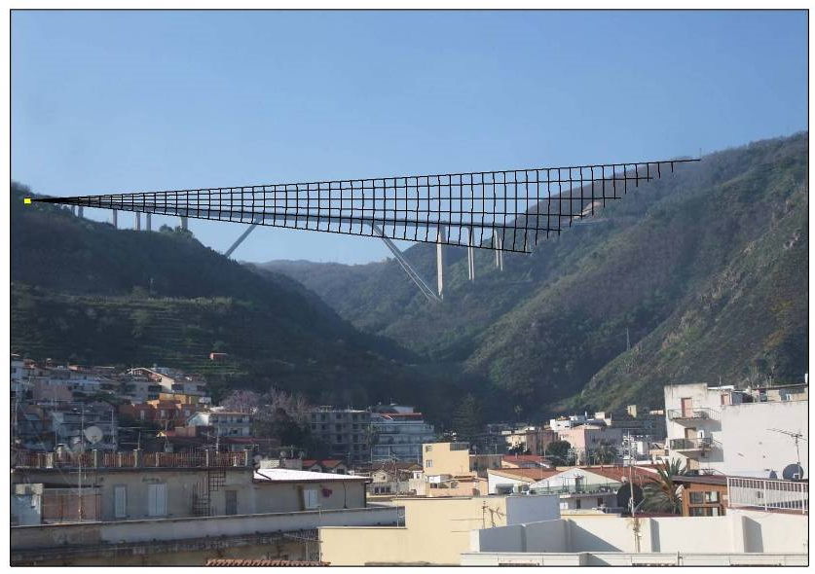
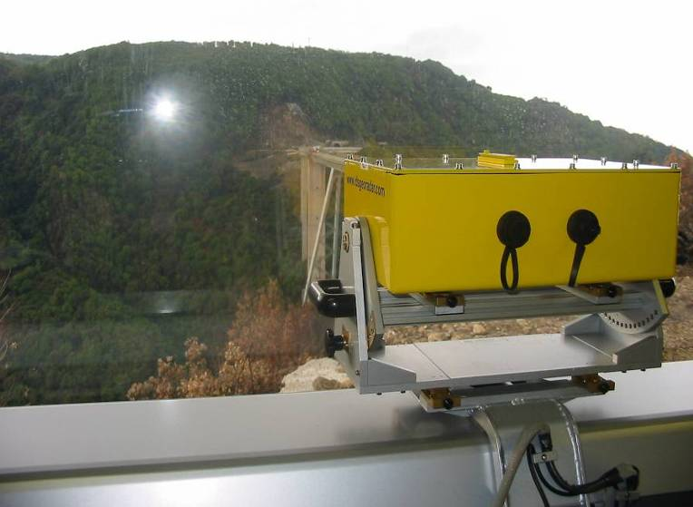
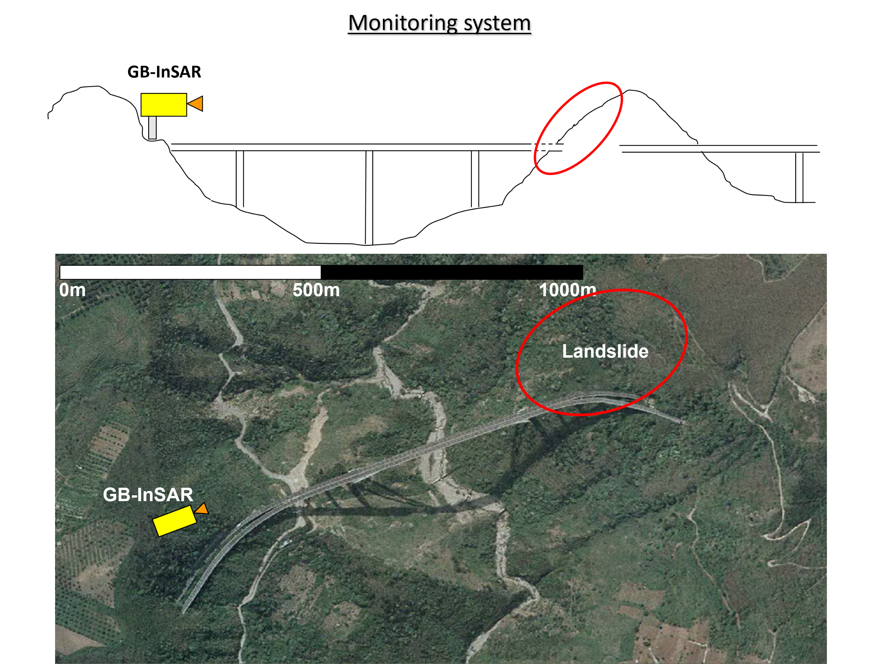
Description of the monitoring system
Notes:
View from the monitoring system.
Has to work 24/7 every weather and not interfear with work activity and change on the slope so something that not required installation
Work at around 1 km plus a lot of other mornitornig instrument where installe inclinometer total station point tensimeter for the rod

Slide 11
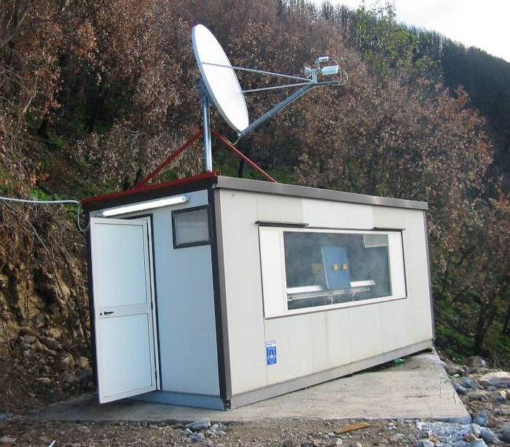
Description of the monitoring system
Notes:
The continuous monitoring of the slope from the middle of 2007 to the end of 2011 allowed collecting a large set of displacement data for the overall slope following various work phases conducted on the slope. Specifically, the following data are available: approximately 20,000 photos, 250,000 measurements of weather data, 400,000 SAR images collected from the same position, 160 inclinometric measurement 160 piezometric measurements, 160 topographic measurements, and, finally, 85 load cell measurements
Air condiction you are in Calabria tealed te equippement like computer etc
Imortant the weater ddata used to see if the density of air calculated by temperature humiitu and pressure

Slide 12
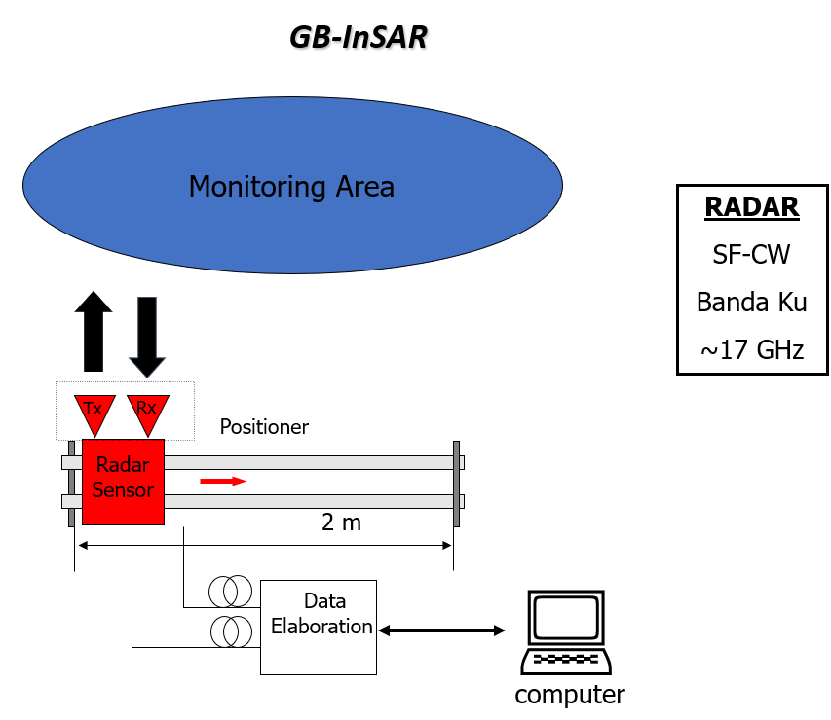
Description of the monitoring system

Slide 13
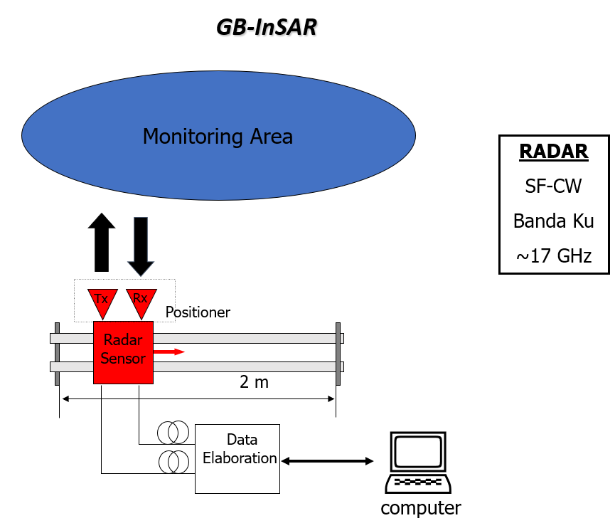
Description of the monitoring system

Slide 14
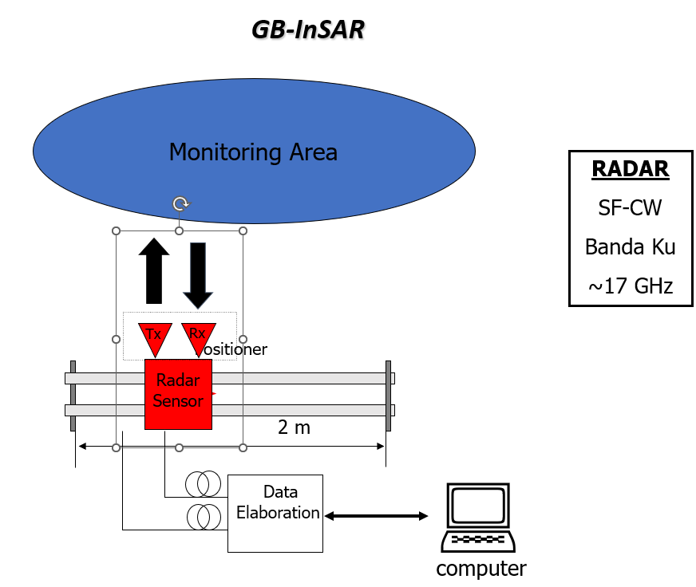
Description of the monitoring system

Slide 15
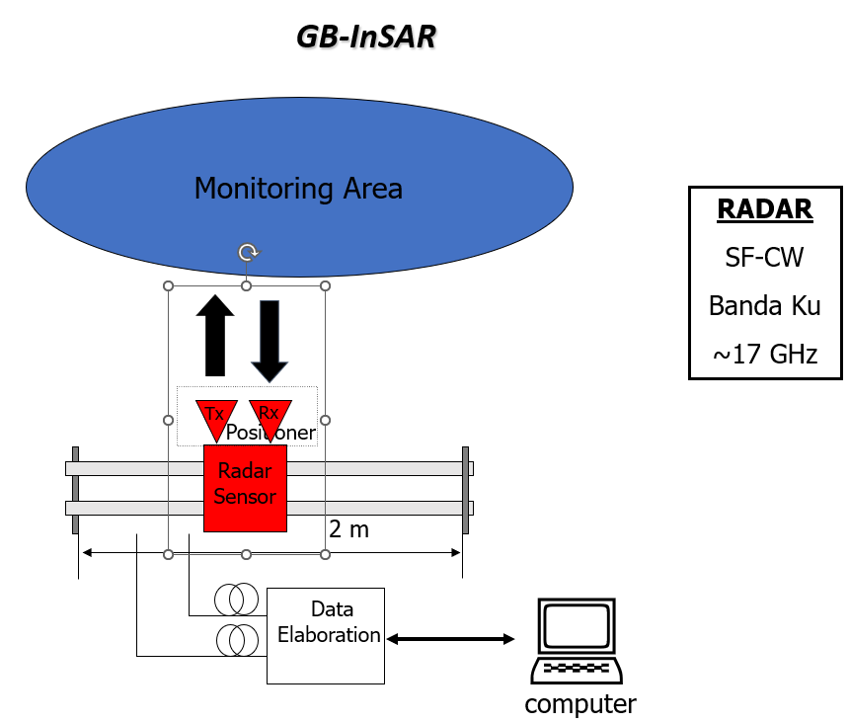
Description of the monitoring system

Slide 16
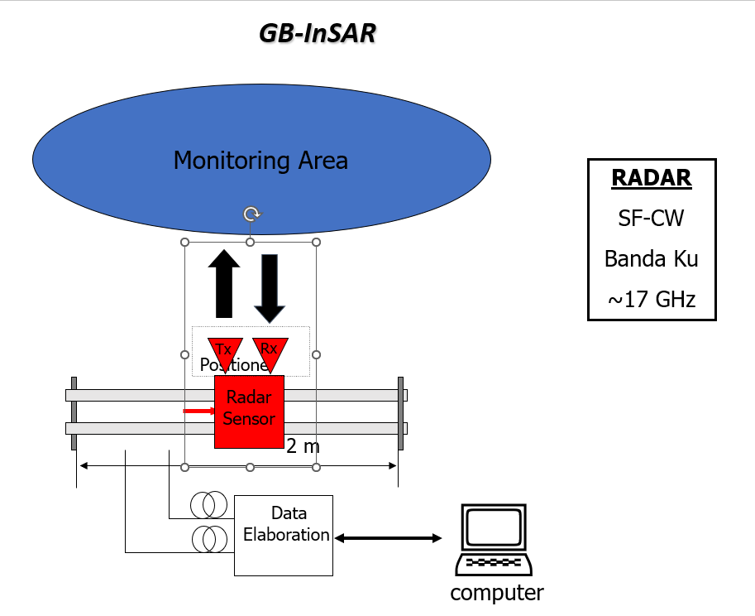
Description of the monitoring system

Slide 17
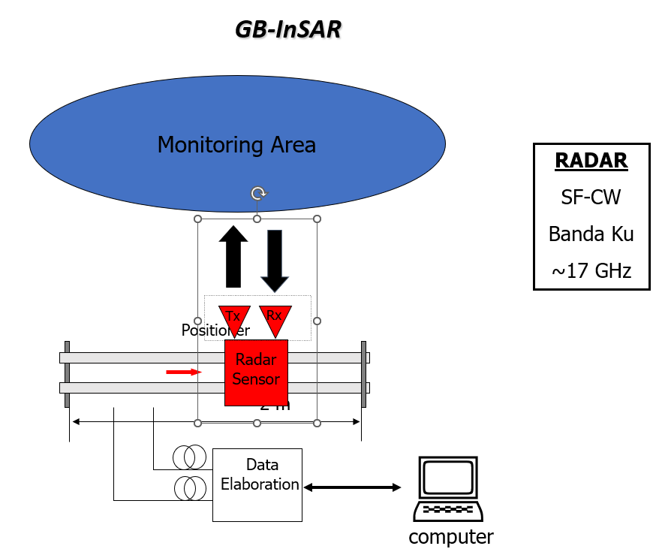
Description of the monitoring system

Slide 18
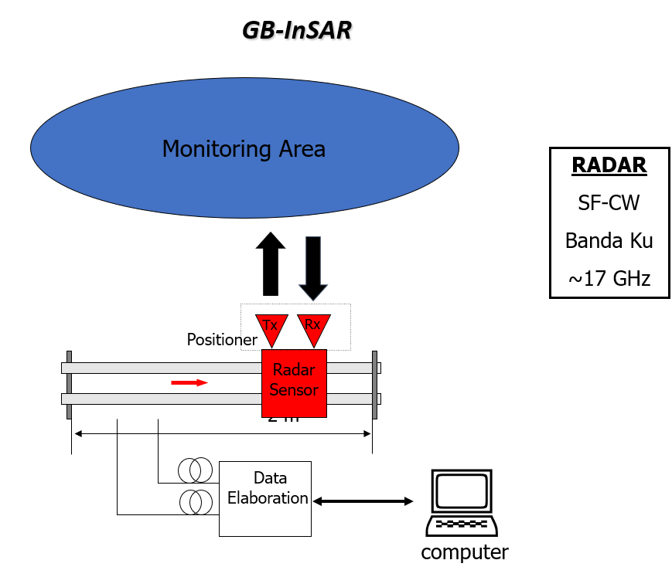
Description of the monitoring system

Slide 19
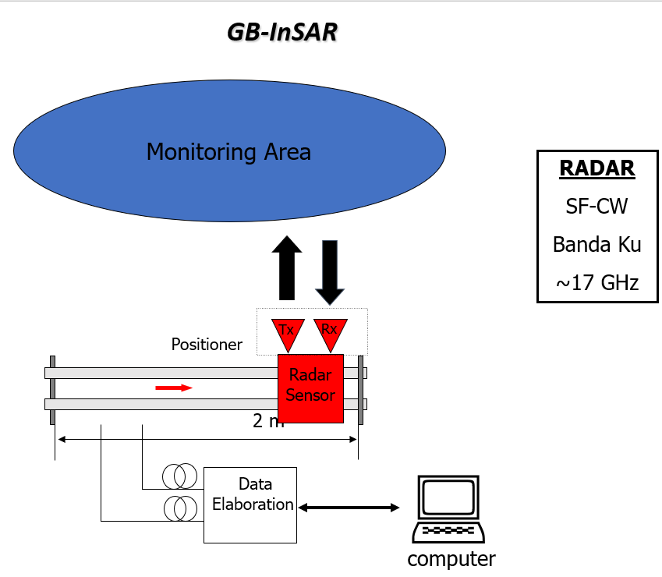
Description of the monitoring system

Slide 20
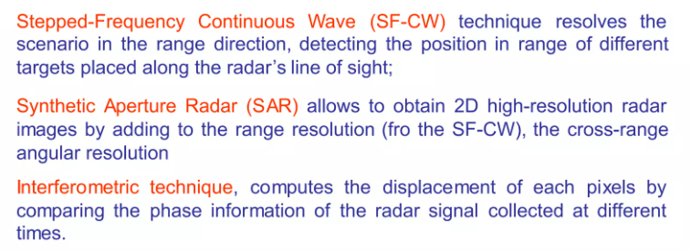
Description of the monitoring system

Slide 21
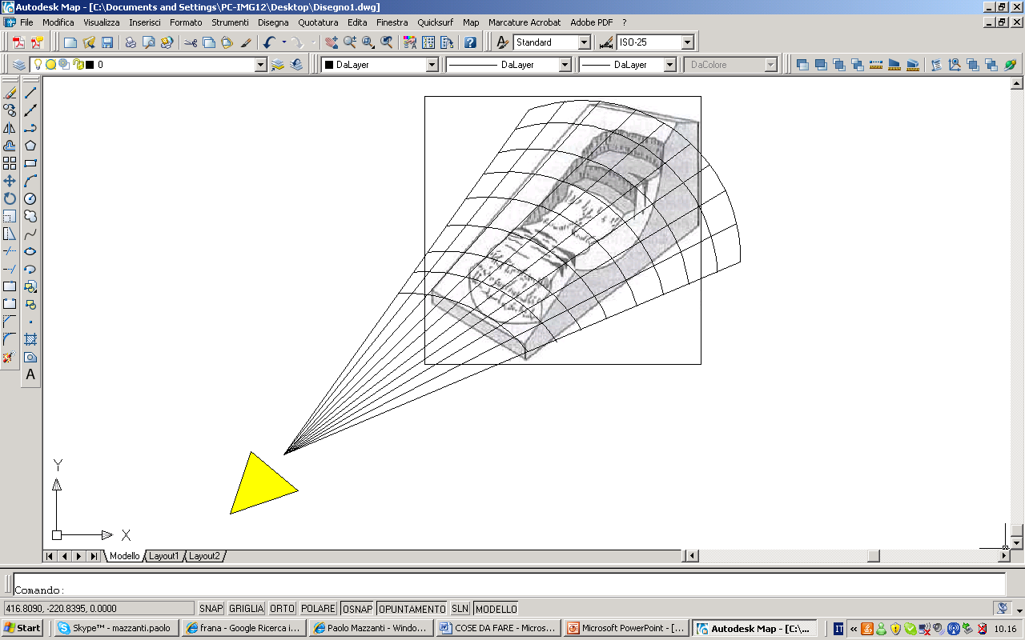
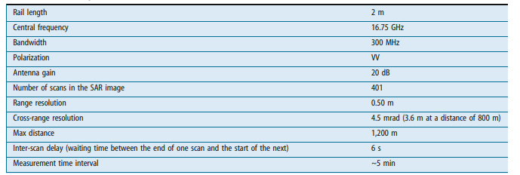
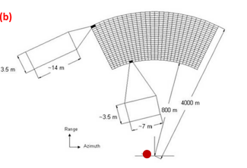
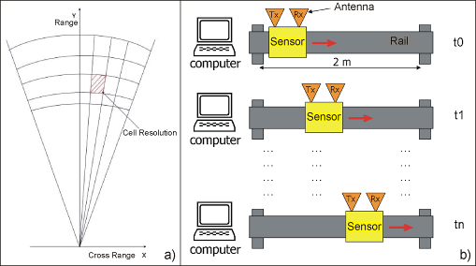
Description of the monitoring system
Notes:
Syntethic aperture Radar increase azimuth resolution. Atmospheric refraction in satellite weather condition in BG-InSar. Phase unbiguity. Radio detection and range RADAR, Interferpmetric Syntethic Aperture Radar
Yiu have an area, but only the most reflective point will be important for the total displaceemt
Line of sight against real diasplacement

Slide 22
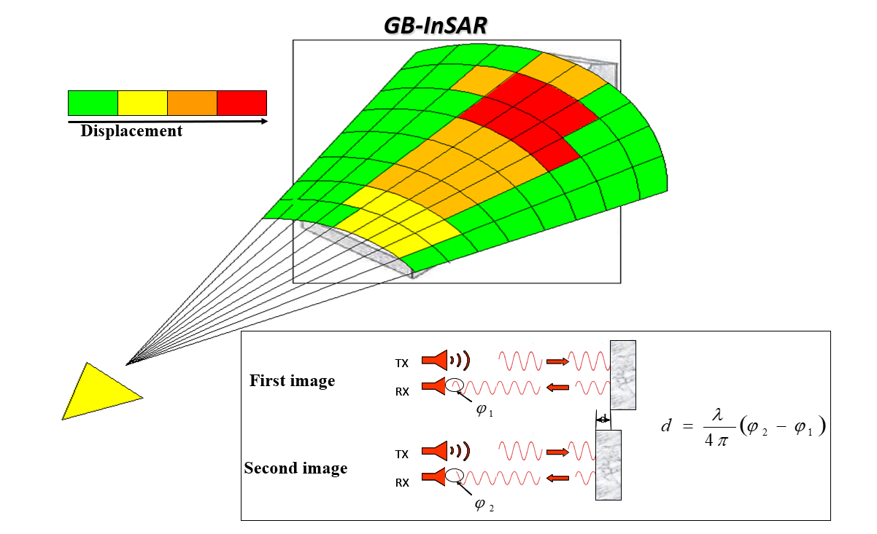
Description of the monitoring system
Notes:
This means that considering a wavelength of approximately 17 mm and a rail length of 2 m (the features of the equipment used in this paper), the cross-range resolution is on the order of 0.4 and 4 m at a distance of 100 and 1,000 m, respectively
It is important to underline that the
expected movement between two discontinuous acquisitions has to be smaller than
λ
/4,
that is 4.3mm for Ku band system and 7.14mm for X band system, to not encounter in
displacement measurement ambiguity.

Slide 23
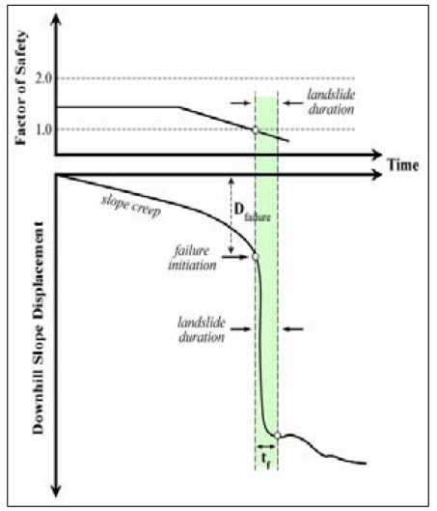
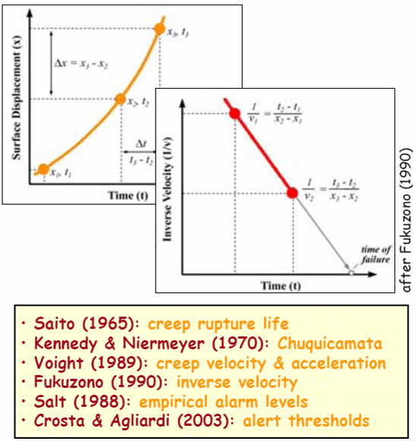
Semi empirical models applied
Notes:
Terzaghi 1950

Slide 24
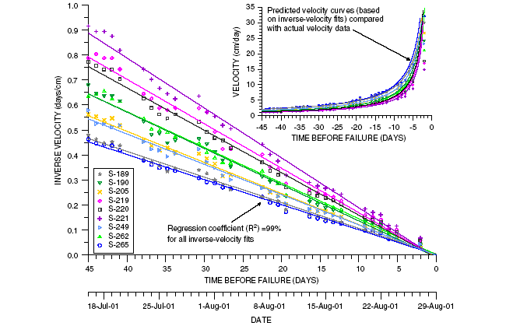
Semi empirical models applied

Slide 25
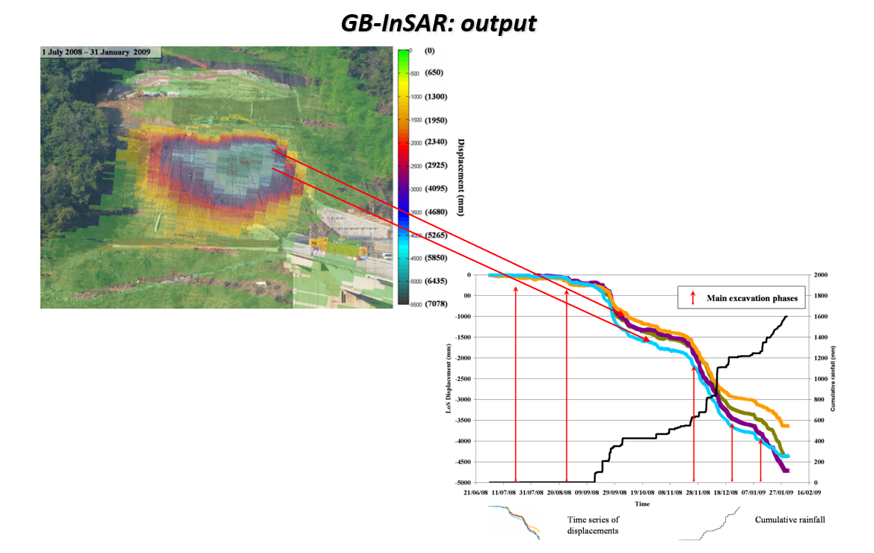
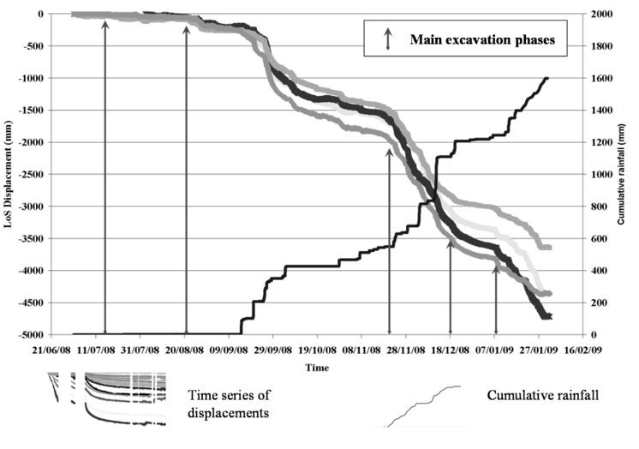
Final result

Slide 26
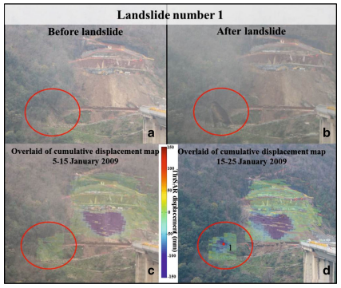
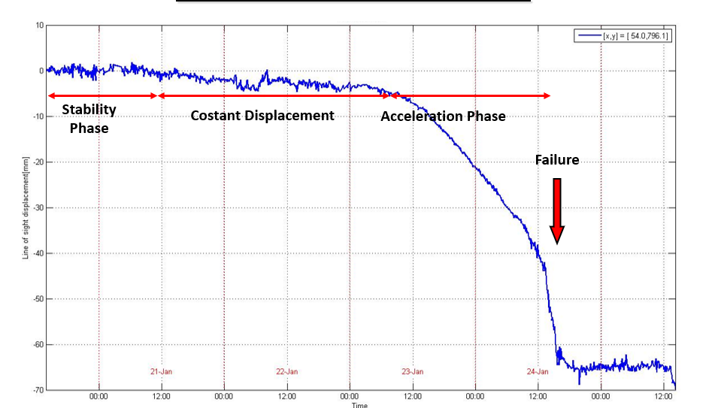
Final result

Slide 27
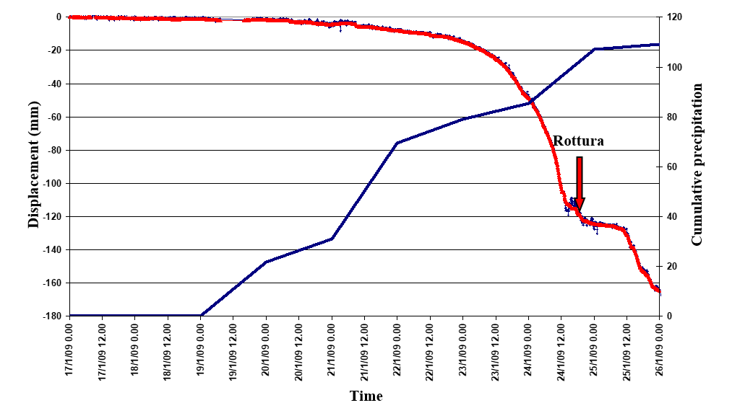
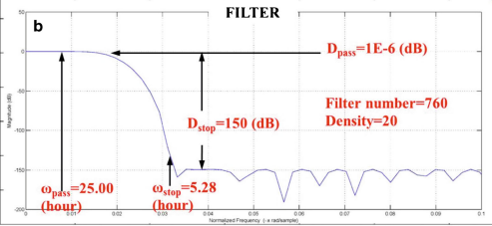
Final result

Slide 28
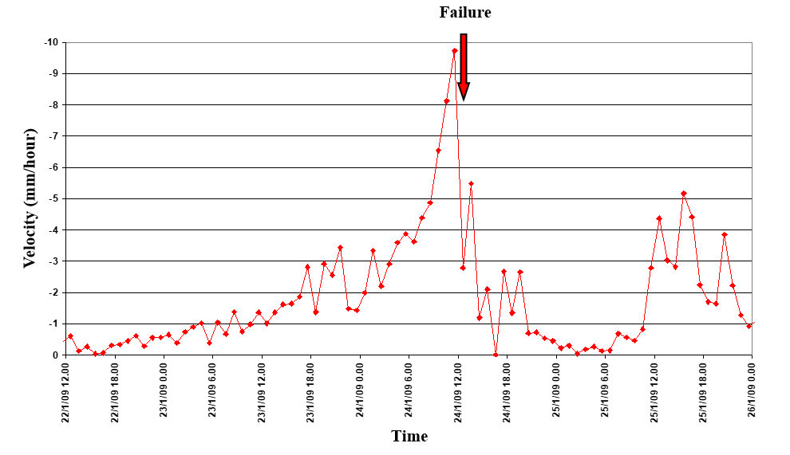

Final result

Slide 29



Final result

Slide 30





I
II
III
IV
V
Fitting landslide with spritz-beton
Fitting landslide without spritz-beton
Frana 1
Without
spritz-beton
Frana 7
Frana 9
Frana 10
Frana 3
With
spritz-beton
Frana 4
Frana 5
Frana 8
I Small acceleration
II Constant acceleration
III Constant velocity
IV Exponential acceleration
V Deceleration
I
II
III
IV
V

Slide 31

FRANE CON SPRITZ-BETON
Frana 3
Frana 6
Frana 8
14/03/2024
Pagina 31

Slide 32

FRANE SENZA SPRITZ-BETON
Frana 1
Frana 2
Frana 9
14/03/2024
Pagina 32

Slide 33

FRANE SENZA SPRITZ-BETON
I
II
III
IV
V
Fitting frane in spritz-beton
Fitting frane non in spritz-beton
Frana 1
Senza
spritz-beton
Frana 7
Frana 9
Frana 10
Frana 3
Con
spritz-beton
Frana 4
Frana 5
Frana 8
I Modesti aumenti di velocità
II Accelerazione costante
III Velocità costante
IV Aumento esponenziale della velocità
V Fase decelerativa
14/03/2024
Pagina 33

Slide 34

FRANE CON SPRITZ-BETON
Fitting frane in spritz-beton
Fitting frane non in spritz-beton
Frana 1
Senza
spritz-beton
Frana 7
Frana 9
Frana 10
Frana 3
Con
spritz-beton
Frana 4
Frana 5
Frana 8
I Modesti aumenti di velocità
II Accelerazione costante
III Velocità costante
IV Aumento esponenziale della velocità
V Fase decelerativa
I
II
III
IV
V

Slide 35

Final result
Notes:
Why all this monotoring data and semi empirical model everything to reduce the risk and the last methodologies we can talk one minuets on the drastic and expensive used here
My prof say now that is finish a will take another road to go to reggio calabria

Slide 36

Discussion about Risk mitigation
Notes:
What you've just done is a single loop called the PDCA Cycle. This is an established tool for achieving continuous improvement in your business.
The PDCA approach was pioneered by Dr William Deming, and we've worked closely with The Deming Institute to produce this article. In it, we outline the key principles of PDCA, and explain when and how to put them into practice.
Download transcript
Click here to view a transcript of this video.
What Is PDCA?
In the 1950s, management consultant Dr William Edwards Deming developed a method of identifying why some products or processes don't work as hoped. His approach has since become a popular strategy tool, used by many different types of organizations. It allows them to formulate theories about what needs to change, and then test them in a "continuous feedback loop.“
During Sprint Retrospectives
During Daily-Scrums

Slide 37

Discussion about Risk mitigation
Notes:
Risk-based software testing looks at two factors – the probability of the bug occurring and the impact of the bug when it occurs. High impact/high probability bugs fixes should be scheduled first: for example, a bug in a particular module of code for an on-line shopping cart algorithm that keeps your business from processing transactions. On the other hand, a bug that introduces a very slight rounding error in that same transaction should have a lower priority.

Slide 38

Discussion about Risk mitigation
Notes:
Royal Dutch Shell is considered to be the first major company to successfully integrate bow-tie diagrams into their business practices, at least since the early 1990s.^{[1][9][10]}

Slide 39




Discussion about Risk mitigation
The Sigma Works
The Delta Works (Dutch: Deltawerken) is a series of construction projects in the southwest of the Netherlands to protect a large area of land around the Rhine–Meuse–Scheldt delta from the sea. Constructed between 1954 and 1997
Notes:
Only to show that belgium learn from hi mistake only a the secon strom netherlands on the first Italy will never learn

Slide 40
Thank you!
Ivan Cipriani

